Slide 1
Integration of Immunization Information Systems for Efficiencies in the National Immunization Survey
A. Elizabeth Allen¹, Megha S. Ravanam¹, Kaitlin Peterson¹
Madeleine R. Valier², James A. Singleton², Lauren Shaw²
¹NORC at the University of Chicago
²Centers for Disease Control and Prevention
August 7, 2024

Slide 2
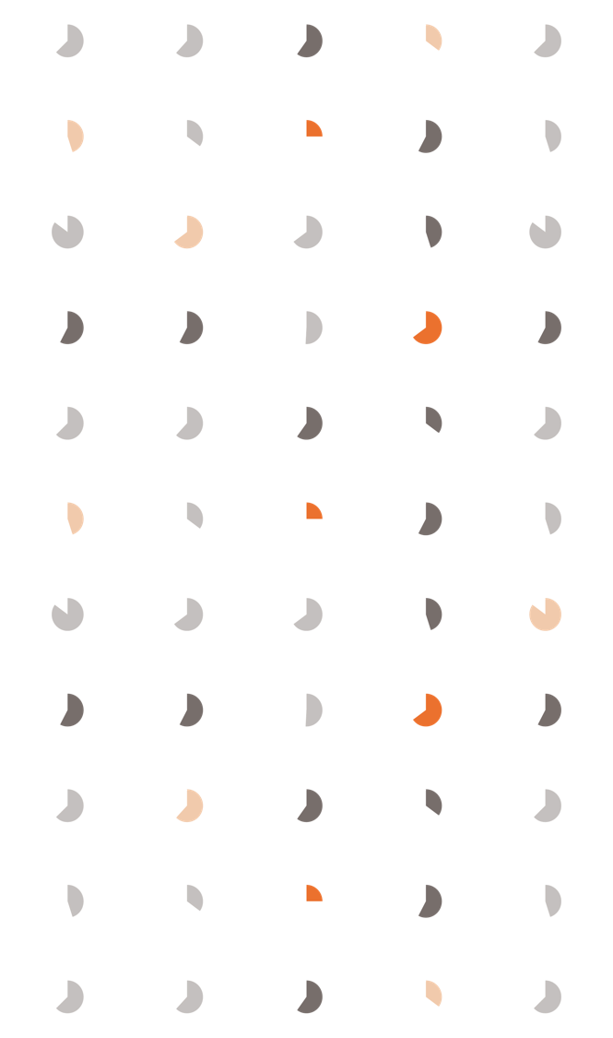
Agenda
 | Agenda
01 | Background
02 | IIS-NIS Integration Plan
03 | Phase 1 Implementation
04 | Phase 2 Considerations
05 | Discussion

Slide 3
Background

Slide 4
Background : National Immunization Survey (NIS) Overview
The NIS is conducted by the Centers for Disease Control and Prevention (CDC) and was implemented in 1994 to monitor vaccination coverage in children after a large measles outbreak
Monitors vaccination coverage estimates for children aged 19-35 months (NIS-Child), adolescents 13-17 years (NIS-Teen), as well as influenza (flu) coverage in children 6 months to 17 years (NIS-Flu)
Also monitoring of COVID-19, influenza, and RSV vaccination for adults with the NIS-Adult COVID Module (NIS-ACM), and monitoring child COVID-19 vaccination within the NIS-Flu module (Fielded from October-June of each year)
Nationwide cell-phone random-digit-dial (RDD) survey
Two stages of data collection for NIS-Child and NIS-Teen:
Household telephone interview to obtain data on child, mother, and household and to gain consent to contact health care providers
Providers mailed an Immunization History Questionnaire (IHQ) for detailed vaccination records
Declining response rates and coverage of NIS age-eligible children has led to increases in data collection costs

Slide 5
Background : National Immunization Survey (NIS) Overview
Immunization Information Systems (IISs) are state or local confidential, computerized, population-based data systems that collect and consolidate information on vaccination doses administered to individuals by participating vaccination providers
IISs exist in all states, five large cities, the District of Columbia, and 8 U.S. territories
Functional standards established to describe the operations, data quality, and technology needed to support immunization programs, vaccination providers, and other immunization stakeholders with their immunization-related goals
Varying levels of completeness of the population of children 6 months to 17 years of age within IIS databases
Varying levels of completeness of child vaccination histories for children included in IISs

Slide 6
IIS-NIS Integration

Slide 7
Background : National Immunization Survey (NIS) Overview
Goals for IIS-NIS Integration
One integrated system for vaccination coverage assessment across local, state, and national levels
Reduce reliance on survey methods
Declining response rates and increasing costs
Public and vaccination provider burden
Improve efficiency of NIS data collection, resulting in either
Lower cost for same amount of data
More data at same cost

Slide 8
The path to full IIS-NIS integration
Phase 1
Phase 2
IIS serves as the primary sampling frame (RDD frame dropped or reduced)
Phase 4
IIS serves as the sole sampling frame
Phase 3
Phone numbers from IIS augment the NIS cell phone random-digit dial (RDD) sampling frame
Vaccination data collected via the NIS provider record check (PRC)
Vaccination data collected via the NIS PRC
Vaccination data collected from both NIS PRC and IIS
Vaccination data collected from IIS only (drop the NIS PRC)
IIS serves as the sole sampling frame

Slide 9
Phase 1 Implementation

Slide 10
IIS-NIS Integration Status: Phase 1 overview
Goal of Phase 1 is to leverage the rich data available in the IIS to make the NIS RDD sample more efficient
Over time, response rates have decreased for surveys
Millions of phone numbers are dialed each year to attain the required number of completed surveys to meet statistical requirements
In Phase 1, an oversample of cell-phone numbers in the RDD frame are matched to the IIS data to create a more efficient frame, while still maintaining representation of the population of children in cell-phone households
Vaccination data are still collected via the NIS PRC

Slide 11
IIS-NIS Integration Status: Phase 1 overview
The RDD sample is matched to the IIS data and subsequently classified into one of the following sampling strata sequentially:
Numbers associated with a child 19-35 months
Numbers associated with a teen 13-17 years
Numbers associated with a child 6-18 months or 3-12 years
Numbers not matched to any child 6 months to 17 years

Slide 12
IIS-NIS Integration Status: Phase 1 overview
A stratified sampling approach makes the NIS more efficient, allowing for increased NIS-Child sample size in participating areas
All four strata of numbers are dialed, not just those matched to phone numbers in the registry data associated with children
Children are still found in the stratum where numbers are not matched to any child
This could be for multiple reasons:
A child may have moved recently into the state
A new phone number was obtained by the parent or guardian
Contact information on the IIS data may be incomplete
Ultimately, under this Phase 1 approach, we see efficiency in data collection resulting in either same sample size at a lower cost or larger sample size for same cost
Approximately 25% increase in number of targeted household interviews for NIS-Child among the participating areas in 2023
Main benefit seen for NIS-Child and less for other NIS surveys

Slide 13
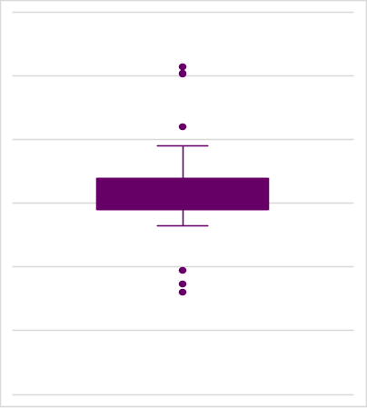
IIS-NIS Integration Status: Phase 1 overview
Under a fixed cost scenario, participating jurisdictions attained ~25% more completed interviews on average compared to jurisdictions that did not participate in 2023 Integration
Distribution of Additional Completed NIS-Child Interviews in Phase 1
0% 10% 20% 30% 40% 50% 60%

Slide 14
IIS-NIS Integration Status: Phase 1 overview
Participating jurisdictions are asked to establish a Data Use Agreement (DUA) with NORC and create a data extract on a quarterly basis
NORC provides specifications for data and fields required; participating jurisdictions are asked to extract and upload files of phone number and age flags to a secured FTP site quarterly
The number of participating jurisdictions has steadily increased, with a vast majority continuing participation each year once they have participated
2019: 12 jurisdictions*
2020: 18 jurisdictions
2021: 27 jurisdictions
2022: 29 jurisdictions
2023: 33 jurisdictions
2024: 34 jurisdictions
*11 of the initial 12 jurisdictions have been consistently involved over the six years of data collection (2019-2024)
Largest barriers to participation continue to be State/Local/Agency laws prohibiting data sharing, and staffing/resource constraints at the IIS level

Slide 15
Phase 2 Considerations

Slide 16
IIS-NIS Integration Status: Phase 2 overview
Currently assessing participating jurisdictions’ ability to participate in Phase 2
With many jurisdictions participating in Phase 1, we are starting to consider what a Phase 2 integration plan would look like
Phase 2 differs from Phase 1 primarily with respect to the sampling stage
IIS serves as the primary sampling frame
RDD frame is either dropped or reduced
Vaccination data are still collected through the NIS PRC process
Official vaccination coverage estimates are based on provider-reported vaccination records as is currently done

Slide 17
IIS-NIS Integration Status: Phase 2 overview
When assessing the readiness of an IIS for Phase 2 of integration, key considerations might be:
Are there an acceptable number of children in the IIS relative to the number of children in the population? (Coverage Index, Enrollment Index, Participation Index)
Among children in the IIS, is the availability of contact information acceptable? (Contact Index)
Among children in the IIS with contact information, is the accuracy of that contact information acceptable? (Eligibility Rate)
Overall, of the children in the target population, is the proportion that are in the IIS with available, accurate contact information acceptable? (Distribution of Children by IIS Stratum)
Are the IIS’s policies and procedures for populating the IIS, obtaining contact information, and sharing data acceptable? Has the IIS demonstrated an ability to share the necessary data in a consistent, accurate, and timely fashion? (IIS Policies)
Would vaccination coverage rate estimates produced under Phase 2 be acceptably accurate? (Accuracy of Estimates)
To be potentially ready for Phase 2 integration:
IIS includes ≥90% of children/teens in the population who have corresponding phone numbers/addresses
Strata 1-3 covers ≥50% of the child/teen population
Simulated phase 2 vaccination coverage estimates have an absolute differential bias <2.5% for all NIS surveys

Slide 18
IIS-NIS Integration Status: Phase 2 overview
Multiple approaches for Phase 2, which aims for the IIS to serve as the sampling frame for the NIS
Variant 1: Large cell-phone RDD sample is matched to telephone numbers associated with children in the IIS, and subsamples from matched numbers are selected
Pros: Data collection cost savings for NIS-Child, can be implemented today without major changes to NIS data collection and estimation procedures
Cons: Lower coverage of the target population than the current NIS approach, potential changes in vaccination coverage rate estimates
Variant 2: Select a sample of all age-eligible children in the IIS and conduct interview via cell phone, landline phone, or mail questionnaire in the absence of a phone number
Pros: Higher coverage of the target population compared to Variant 1, additional contact modes available (i.e., landline numbers and addresses)
Cons: Unable to directly assess readiness for Variant 2 at this time because Phase 1 currently only samples phone numbers, sharing of more sensitive information required from states beyond what is currently provided
Under any variant of phase 2, vaccination data are still collected via the NIS PRC

Slide 19
IIS-NIS Integration Status: Phase 2 overview
Currently considering Phase 2, Variant 1 as the next step
It would reduce data collection costs dramatically, potentially resulting in significantly more completed interviews for participating jurisdictions, should the funding continue to be available
It is easy to implement
Uses the same process as Phase 1, but Stratum 4 would be dropped. Nothing additional would be asked of jurisdictions already participating in Phase 1
There may be some risks and unintended consequences
Would want to minimize any possible added bias to the vaccine coverage estimates for any areas that are deemed ready for Phase 2
Analysis on NIS data has been conducted to model what the estimates would have been under a Phase 2, Variant 1 approach, and thresholds will be set based on that analysis
Might need to offset some of the added sample size for NIS-Child to ensure meeting sample size requirements for NIS-Teen and NIS-Flu, as well as the NIS-ACM
Readiness to move to Phase 2, Variant 1 will be assessed for each participating jurisdiction individually

Slide 20
Discussion

Slide 21
Discussion and next steps
Leveraging the IIS data, real efficiencies have been seen under Phase 1, resulting in a larger number of effective completes compared to non-integration areas
Larger sample sizes allow for better precision to assess trends in vaccination coverage by jurisdiction, and more subgroup analysis for key demographics of interest (e.g., race/ethnicity, poverty)
Assuming the case where all 56 areas are participating in the IIS-NIS integration, Phase 2 sample designs provide even more cost-effective options compared to Phase 1 and non-integration areas
Phase 2 sampling designs do not allow us to meet the current requirements for NIS-Teen, NIS-CIM, or NIS-ACM
With the sample design optimized for NIS-Child, the precision requirements for the other modules will not be attained across all areas
Assuming the need for these other modules, Phase 2 would require separate sample needs or additional sample released for the NIS-Child, mitigating potential cost efficiencies
Currently, only 4 areas meet the requirements for Phase 2 integration
Continue to review and monitor participating jurisdictions’ readiness to move from Phase 1 to Phase 2

Slide 22
Questions?

Slide 23
Thank you.
Elizabeth Allen
Principal Statistician
allen-elizabeth@norc.org

